Slide 1
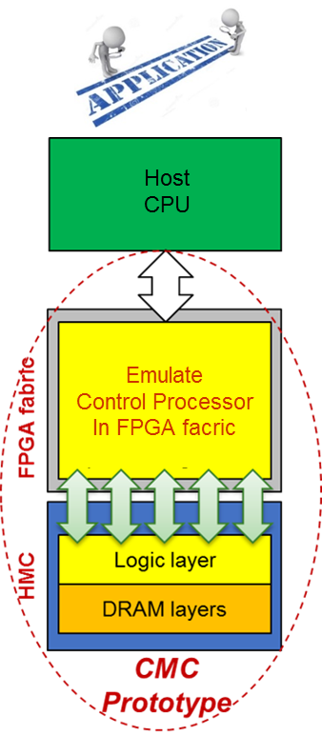
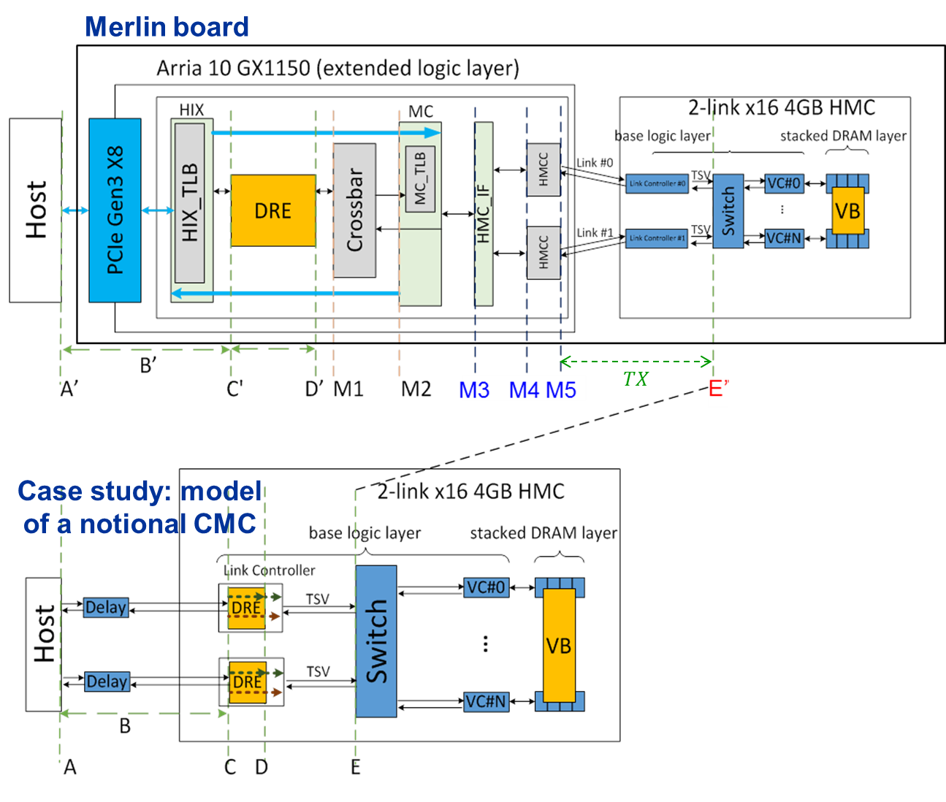
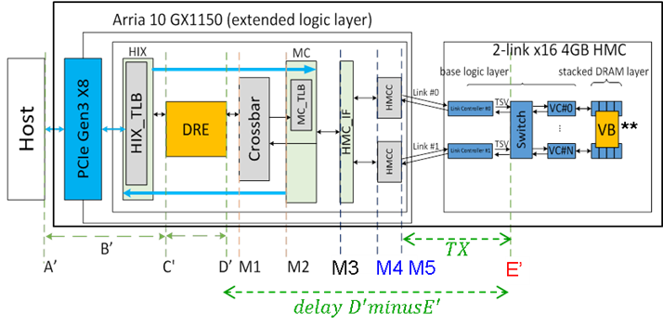
T2: Custom Memory Cube Research Platform
Motivation
Memory bottleneck - critical for memory-intensive Big Data apps
Promise of CMC for C-RAM* & PIM** processing
Goal
Create flexible research platform for design space exploration of CMC apps & arch. before existence of CMC
Approach
Prototype platform:
FPGA + HMC = emulation of CMC
Develop & simplified mapping from measured parameters to model parameters
Platform validation:
Validation of performance measurements on Melrin board
Case study:
Performance measurement and mapping of single memory operations, vector add, DRE operations & applications, etc.

Slide 2
T2: Custom Memory Cube Research Platform
Achievement
Prototype platform: FPGA + HMC = Emulation of CMC
CMC Platform on Merlin board
Implemented on Convey Merlin board from Micron
Observability: instrumented Merlin infrastructure with hardware performance monitors
(C’, D’, M1, M2, M3)
Achievement
Notional CMC architecture*
Performance modelling
Selected notional CMC model from published work
Identified hardware parameters required by performance model
Mapped measurement points to model parameters as required and simplified mapping specifically to pipelined memory access pattern (most common in memory-intensive applications)
Latency A = ctrl signal transfer time B + latency C + result transfer time B
Ctrl signal transfer time B : time to transfer control signals between host and CMC
Data transfer time B: time for host access to obtain result (e.g., transfer from view buffer)
Latency C = latency C’ + delay TSV
Latency: round-trip delay from input into a point in the system to desired outcome
* Nair, R., et al. "Active Memory Cube: A processing-in-memory architecture for exascale systems.“ IBM Journal of Res. & Development 59.2/3 (2015): 17-1.
** VB: view buffer in DRE logic

Slide 3
T2: Custom Memory Cube Research Platform
Achievement
Validation of performance measurements on Merlin board
Merlin board
Approach: compare
Merlin board measurement vs.
HMC SystemC
simulator results
Experiments:
Comparison of average latency of single memory access (Method 1)
Comparison of average latency of single memory access (Method 2)
Comparison of total overlapping latency
(overlapping memory accesses)
SystemC HMC Simulator
PLACEHOLDER of EXPERIMENT RESULTS
Latency: round-trip delay from input into a point in the system to desired outcome
* Nair, R., et al. "Active Memory Cube: A processing-in-memory architecture for exascale systems.“ IBM Journal of Res. & Development 59.2/3 (2015): 17-1.
** VB: view buffer in DRE logic

Slide 4
T2: Custom Memory Cube Research Platform
Achievement
Performance measurement and mapping of CMC operations and applications
Merlin board
PLACEHOLDER of CMC APP EXPERIMENT RESULTS
Latency: round-trip delay from input into a point in the system to desired outcome
* Nair, R., et al. "Active Memory Cube: A processing-in-memory architecture for exascale systems.“ IBM Journal of Res. & Development 59.2/3 (2015): 17-1.
** VB: view buffer in DRE logic

